Slide 1

Object-Oriented Programming Discussion, Lecture, & Lab Eric Pogue
Agenda for Wednesday, October 9th from 2 to 2:50pm CST:
Friendly Conversation Topic – Refactoring in Agile
Assignment from Last Class
FaceDraw Demos
Assignment Q&A
Mosaic Lite Discussion
Assignment for Next Class
Lab
Discussion & Questions welcome at any time… please be present with no phones or email during our time together

Slide 2
Today’s Friendly Conversation Topic – Refactoring

Slide 3
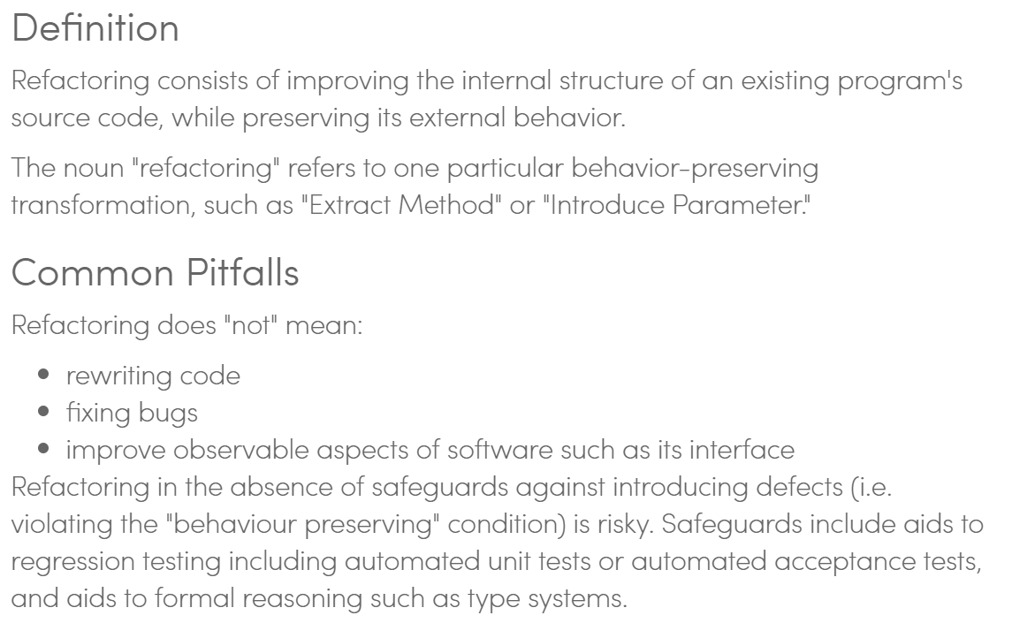
Code Refactoring in Agile Programming

Slide 4
Assignment
Complete Activities List items 1 through 3 and be prepared to discuss them at the start of our next class.
It is important that you complete the MosaicLite tutorial before class on Wednesday so that you can ask questions before the weekend!

Slide 5
Demo Guidelines – Presenter
Everyone will give at least one demo of their work during the semester.
Your demo can include any or all of the following:
A 2 to 5 minute activity
Where you show your application running
Comment on your implementation
Show the source code
Explain how you organized the code
Talk about any challenges
You should not prepare slides or a presentation
You will also need to provide a link to a public Git repository of demo source code in our class forum.

Slide 6
Demo Guidelines – Listener
Everyone will be listening to many demos during the semester.
Your responsibilities during the demo is:
Actively listen and watch what is being demoed
Come up with an meaning yet easy to answer question
During or after the demo ask your question if the presenter does not get “sufficient” questions from other listeners
Do not ask hard question or attempt to review the presenters code
Clap for the presenter at the end of the demo and thank them for presenting
If you have a hard question or want to make a recommendation, do it later and in private

Slide 8
Assignment Q&A

Slide 9
Mosaic Lite Discussion

Slide 10
Assignment
Complete a “pre-release” version of your Mosaic application prior to class on call on Monday. This means that you will be complete with Activities List items 1-3 and part way through item 4.

Slide 11
Lab
As A Scrum Team:
Complete Discussion Board 4 as a team (14 minutes):
Assign a note taker and presenter
Discuss DB4 as a team
Identify participants and key discussion topics topics in notes
Share notes with team and copy/paste notes into individual DB4 (participants only)
Present overview
Demo presenters work together to complete Demo assignment activities
Work on Mosaic
Team report out by new Scrum Master at 2:46
Team Report Out Guidelines
Scrum Master will stand up, give your name, your team name, and briefly answer the following questions:
What did you accomplish since the last meeting? And what will you be working on until the next meeting?
Is the team committed to completing assignments? All/Most/Some
What is getting in your way or keeping you from completing the assignments?

Slide 12
End of Session

Slide 13
Technology, Security, & Privacy

Slide 14
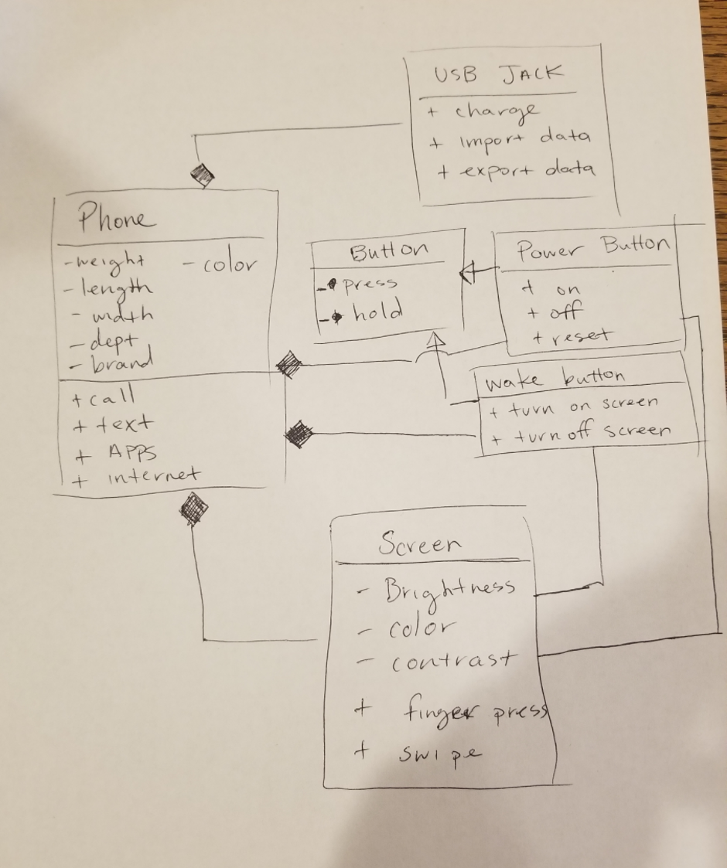
UML Phone Example

Slide 15
Remaining Schedule

